Slide 1
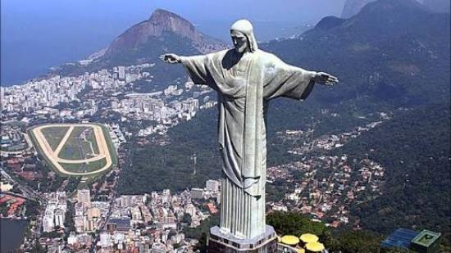
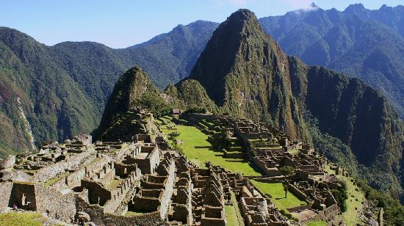
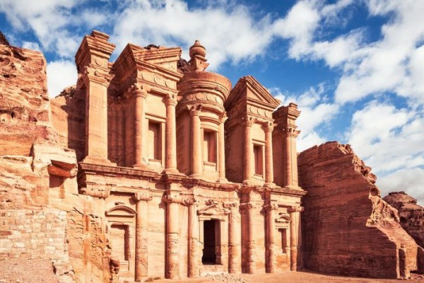
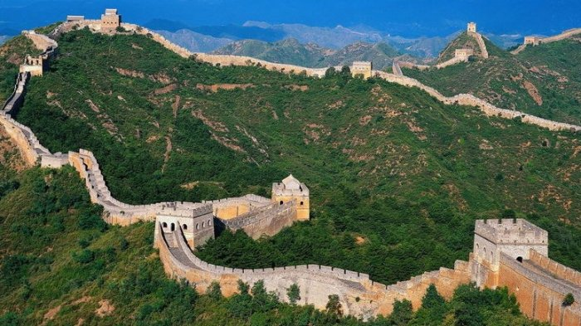
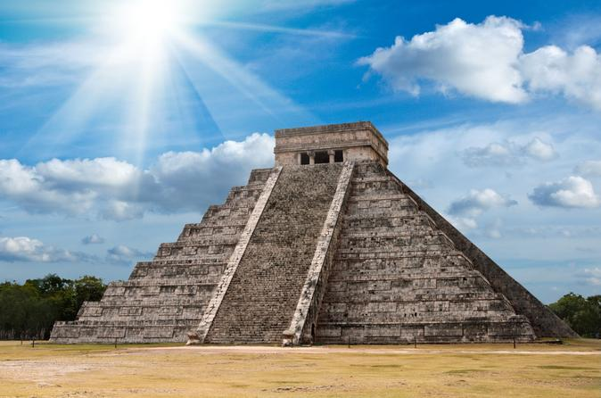
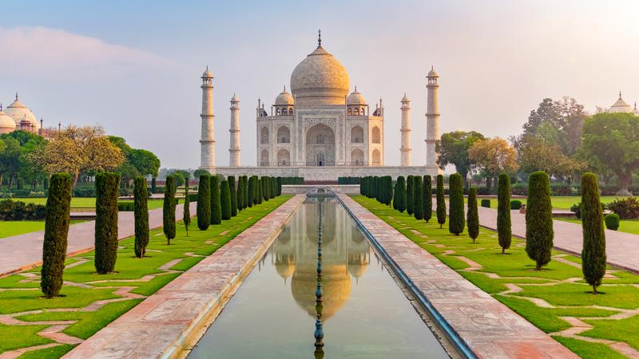
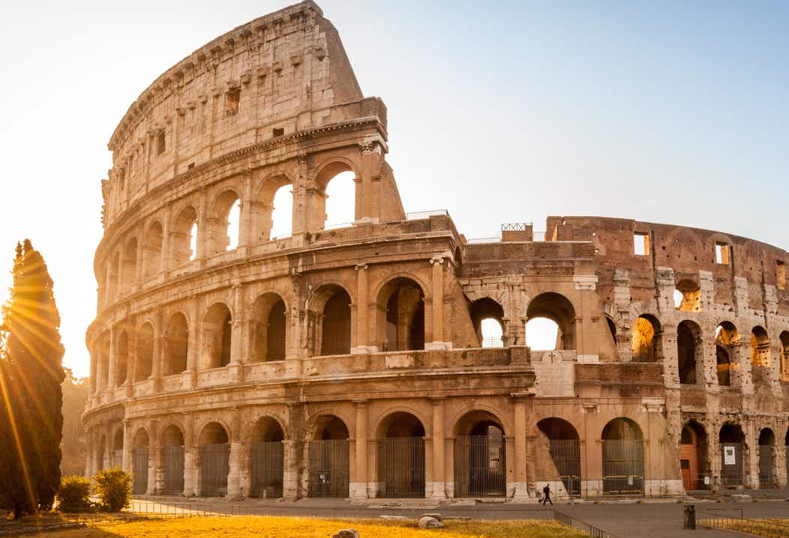
SEVEN WONDER OF THE WORLD
Bintang Refani Mauludi – 2103161052
3 D3 Teknik Informatika B

Slide 2
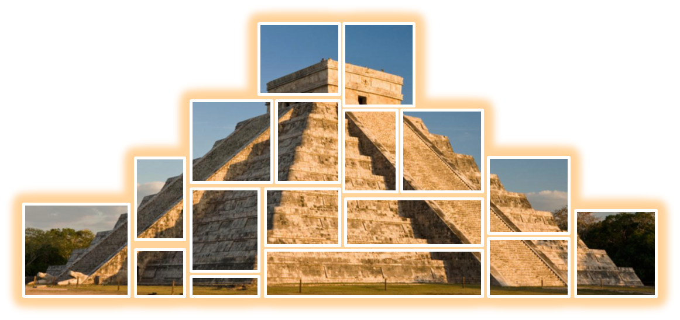
SUPRISING SECRET OF CHICHEN ITZA IN MEXICO

Slide 3

What is Chichen Itza ??
Mexico??
What happen in there ??
Suprising Secret ??
Never heard about that !!
I dont know about that??

Slide 4
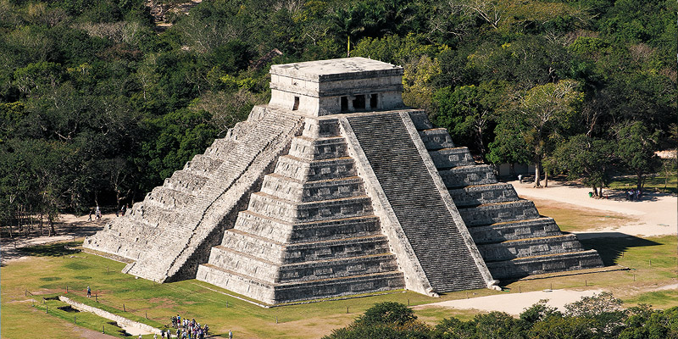
Introduction about Chichen Itza
in Mexico

Slide 5
600 AD
Chichen Itza was build
Chichen Itza becomes a UNESCO World Heritage Site
1988
2007
Chichen Itza was voted in a global survey as one of the New Seven Wonders of the World
Notes:
Chichen Itza dinobatkan sebagai Situs Warisan Dunia UNESCO pada tahun 1988 dan, pada 2007, terpilih dalam survei global sebagai salah satu dari Tujuh Keajaiban Dunia Baru
1988 : Chichen Itza was named a UNESCO World Heritage Site
2007 : Chichen Itza was voted in a global survey as one of the New Seven Wonders of the Worldah

Slide 6
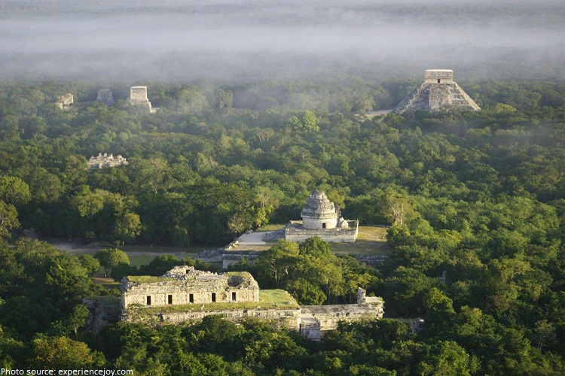
ABOUT
Chichén Itzá, ruined ancient Maya city an area of 10 square km in south-central Yucatán state, Mexico
Notes:
Chichén Itza, kota Maya kuno yang hancur seluas 10 km2 di selatan-tengah negara bagian Yucatán, Meksiko.

Slide 7


CHICHEN ITZA
Itzá is the name of the Maya tribe that settled there
chi (“mouths”), chen (“wells”)
Two big cenotes
Notes:
Two big cenotes on the site made it a suitable place for the city and gave it its name chichen itza. The only source of water in the arid region around the site is from wells (cenotes) formed by sinkholes in limestone formations.
Dua cenote besar di situs membuatnya menjadi tempat yang cocok untuk kota dan memberinya nama chichen itza. Dua cenote besar di situs membuatnya menjadi tempat yang cocok untuk kota dan memberinya nama

Slide 8
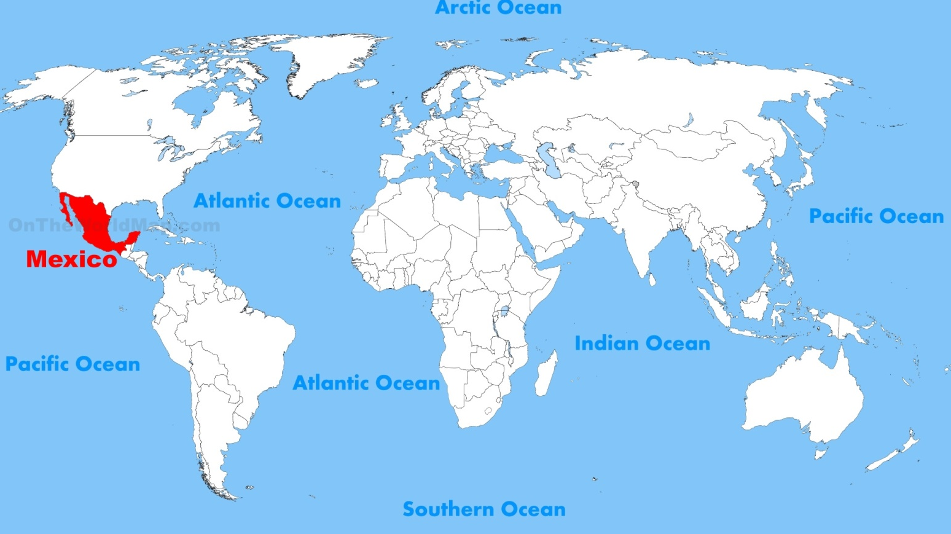

Location of Chichen Itza

Slide 9
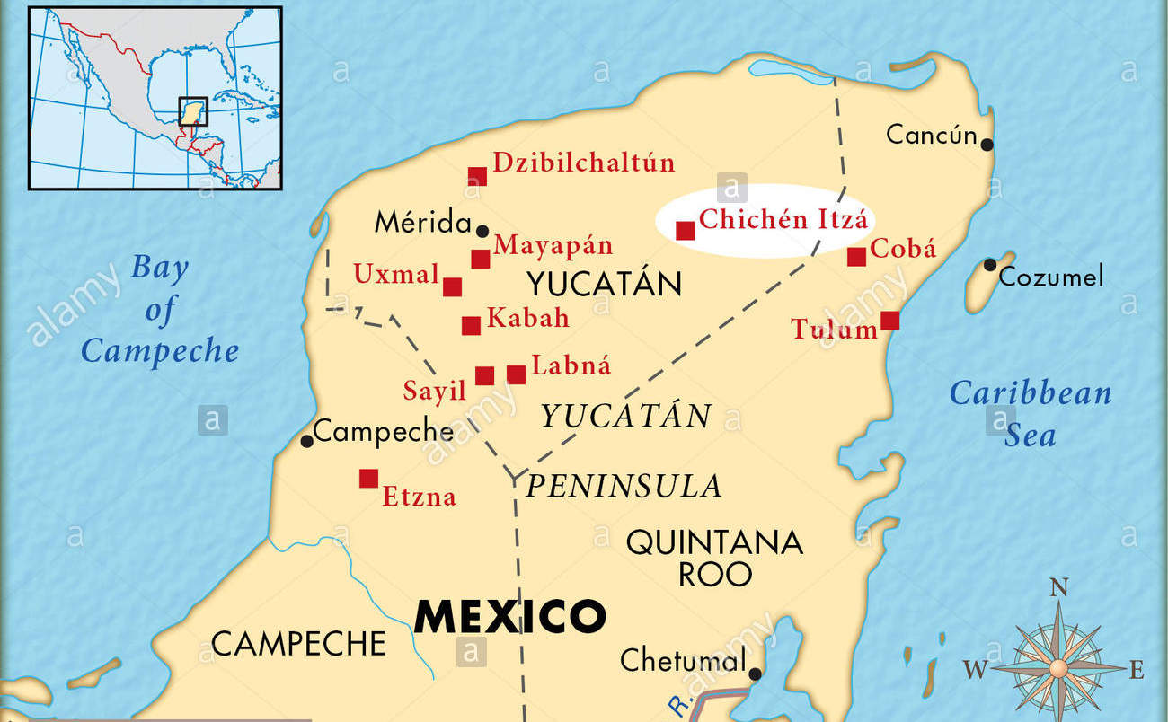


Slide 10
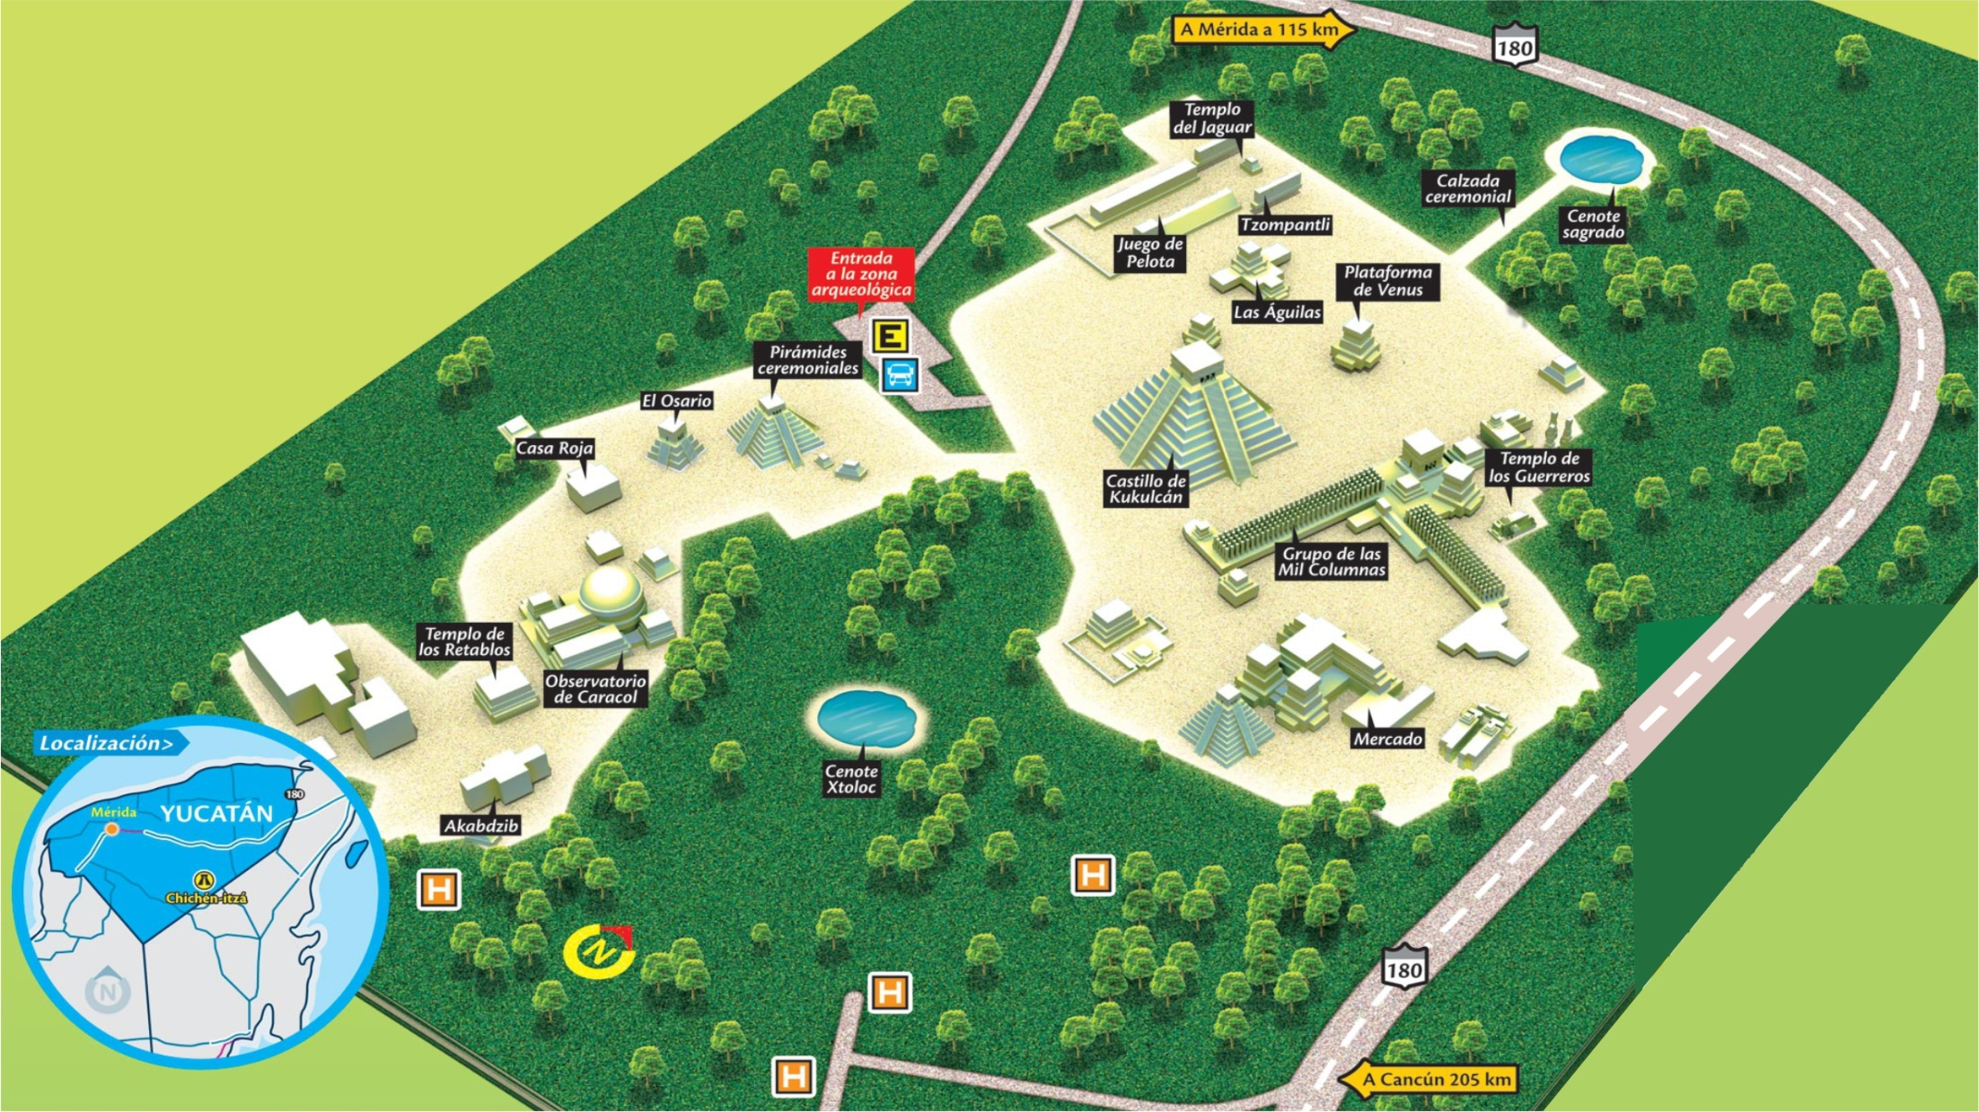
Map of Chichen Itza
El Castillo
Notes:
The central and most impressive structure in the Chichen Itza complex is the el castillo

Slide 11
Map of Chichen Itza
Cernote Sagrado

Slide 12
Map of Chichen Itza
Cernote Sagrado

Slide 13

EL Castillo

Slide 14
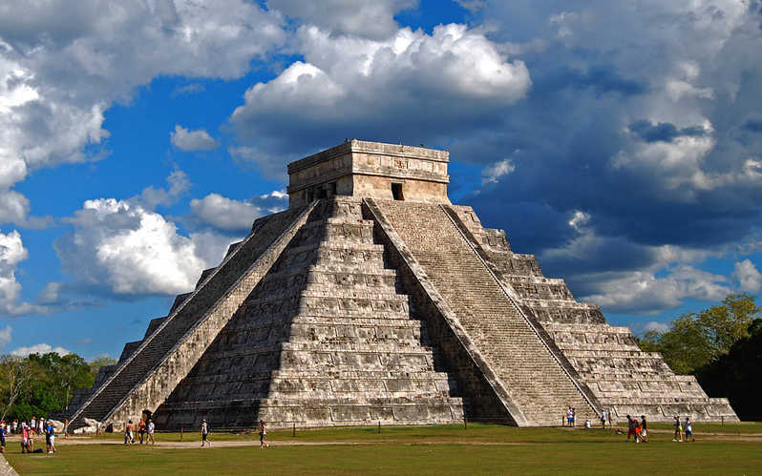
EL Castillo
[ Kukulkan's Pyramid ]
EL Castillo served as a center for sacrifice and preaching
El Castillo was dedicated to the Feathered Serpent

Slide 15
The Great Ball Court

Slide 16
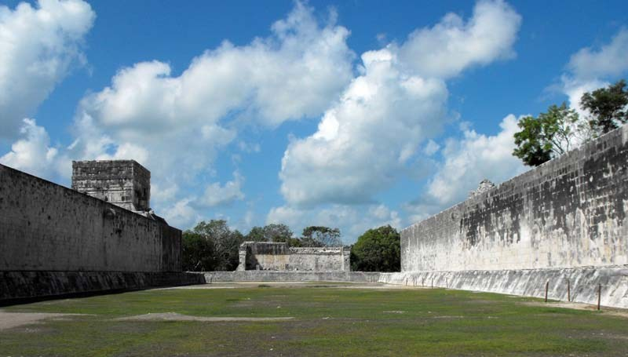
The Great Ball Court
The Great Ball Court at is the largest playing field.
Legends say that the winning Capitan would present his own head to the losing Capitan.

Slide 17
Cenote Sagrado

Slide 18
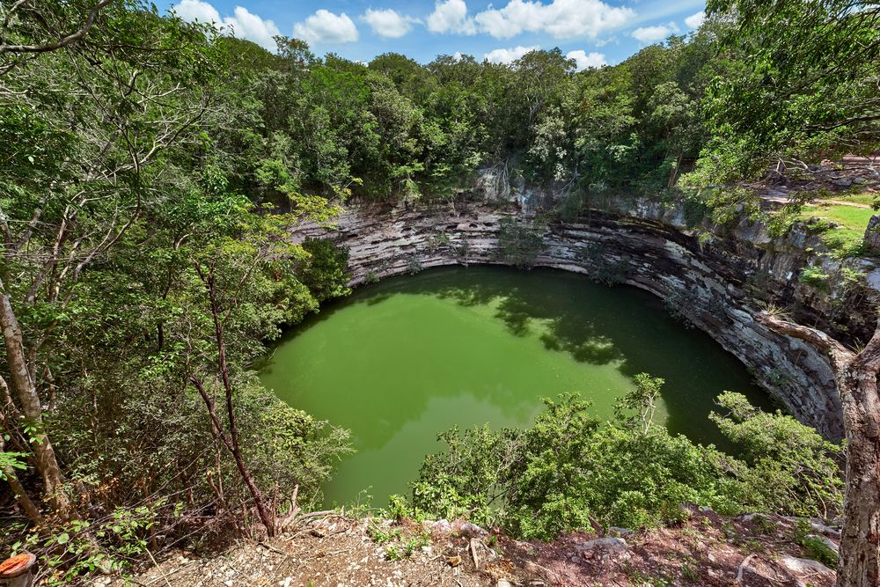
Cenote Sagrado
The Cenote Sagrado was a place of pilgrimage for ancient Maya people
Cenote Sagrado for sacrifices. Sacrifice is done by releasing people during the dry season.

Slide 19
El Caracol

Slide 20
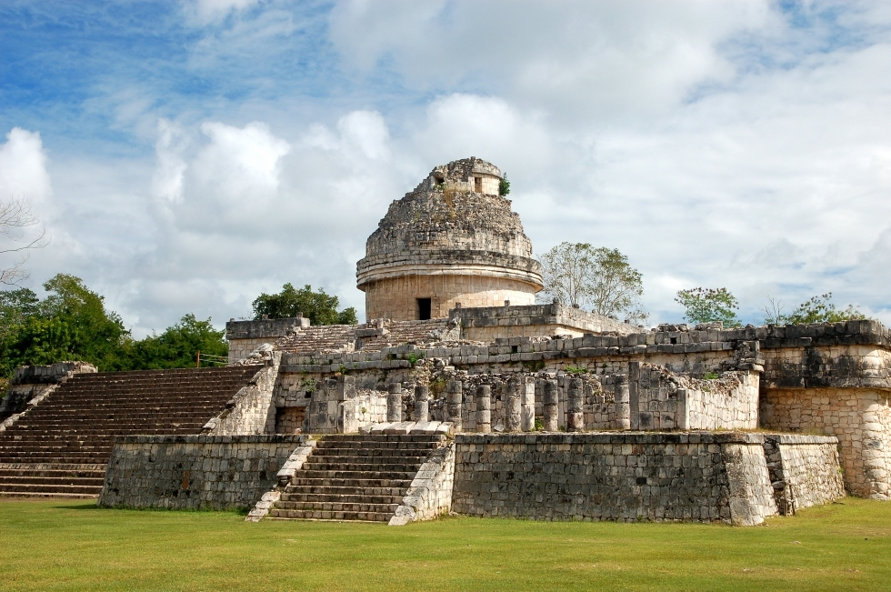
El Caracol
El caracol was used as an observatory

Slide 21
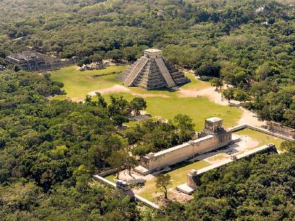
Fascinating history of Chichen Itza Mexico

Slide 22
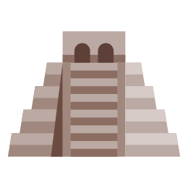
900 - 1200
The Toltec Civilization
Now
250 to AD 900
The Mayan Civilization
1224
The itza Civilization

Slide 23
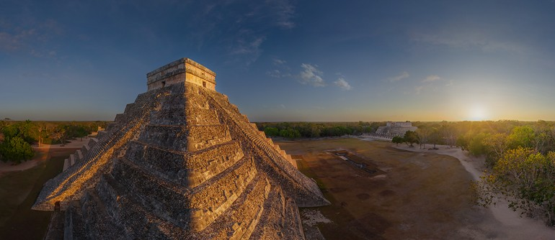
The special architecture Chichen Itza Mexico

Slide 24
EL Castillo

Slide 25
EL Castillo
[ Kukulkan's Pyramid ]
Each stairway climbing the pyramid has 91steps, except the northern side which has 92, and so, adding all four together, one arrives at a significant 365.

Slide 26
The Great Ball Court

Slide 27
The Great Ball Court
The Great Ballcourt of Chichen Itza is 225 feet wide and 545 feet long overall. It has no vault, no discontinuity between the walls and is totally open to the blue sky.
Notes:
The Mayans were great sportsmen and build huge ballcourts to play all their games. The Great Ballcourt of Chichen Itza is 225 feet wide and 545 feet long overall. It has no vault, no discontinuity between the walls and is totally open to the blue sky.
Each end has a raised to the temple area. A whisper from end can be heard clearly enough at the other end 500 feet far away and through the length and breath of the court.
The sound waves are unaffected by wind direction or time of day and also night. Archaeologists engaged in the reconstruction noted that the sound transmission became more and more strong and clear as they proceeded.
In 1931 Leopold Stokowski spent 4 days at this site to determine the acoustic principals that could be applied to theater for an open-air concert he was designing. Stokowski failed to learn the secret.
Today it has not been explained.
It is easy to imagine a Mayan King sitting here presiding over the games. Legends say that the winning Capitan would present his own head to the losing Capitan, who then decapitates him. While this may seem very strange reward, the Mayans believed that this to be the ultimate honor.
The winning Capitan getting a direct ticket for heaven instead of going through the 13 high steps that the Mayan's believed they had to go through in order to reach peaceful heaven..

Slide 28
Cenote Sagrado

Slide 29
Cenote Sagrado
Cenote (say-NO-tay) is the Spanish equivalent of the Yucatec Maya word for a water-filled limestone sinkhole

Slide 30
El Caracol

Slide 31
El Caracol
The vault is over 10 m high, the largest such Maya structure.

Slide 32
History is not a burden on the memory but an illumination of the soul.
- Lord Acton -

Slide 33
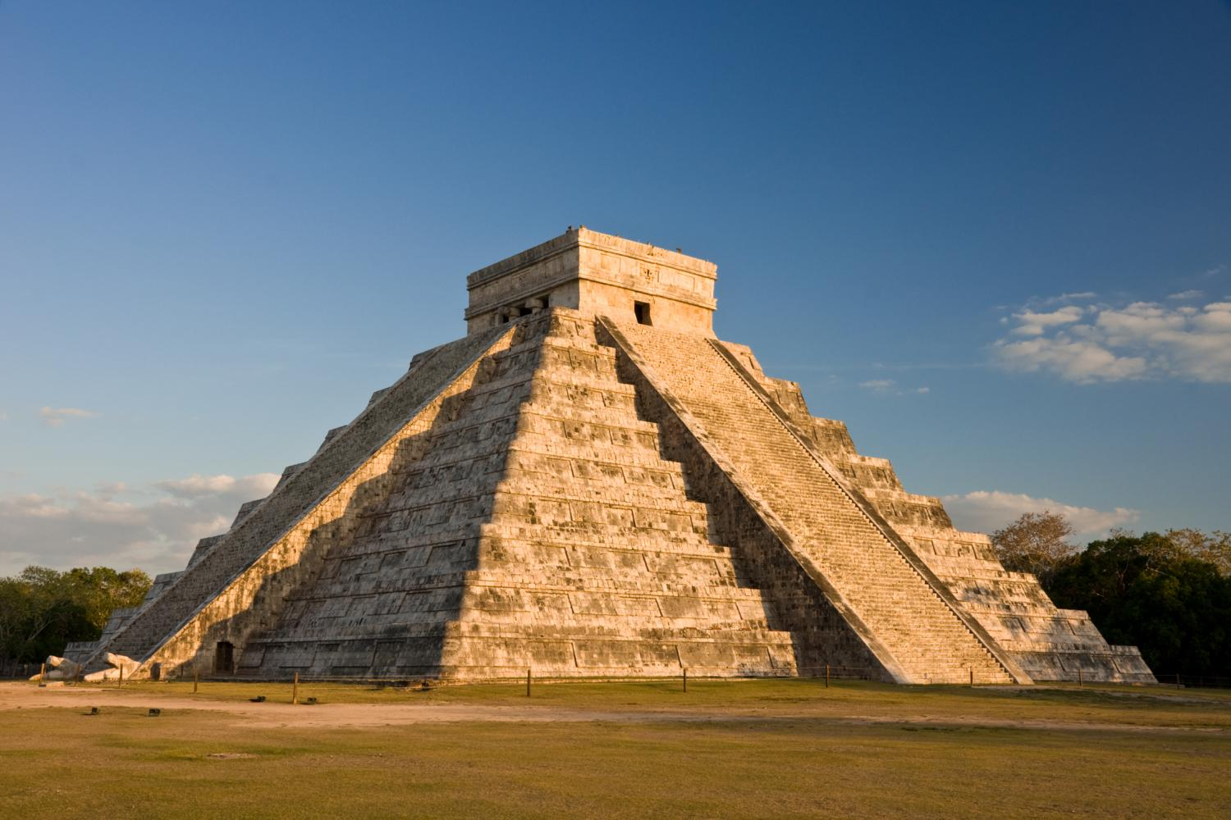
THANK YOU

